Slide 1
Improving SHiP++ Policy
By: Jonathan Pollard

Slide 2
Topics
Background
Abstract
Bypassing with SHiP++
Priority writeback eviction
Combining Bypassing and Priority writeback eviction
Overhead
Conclusion

Slide 3
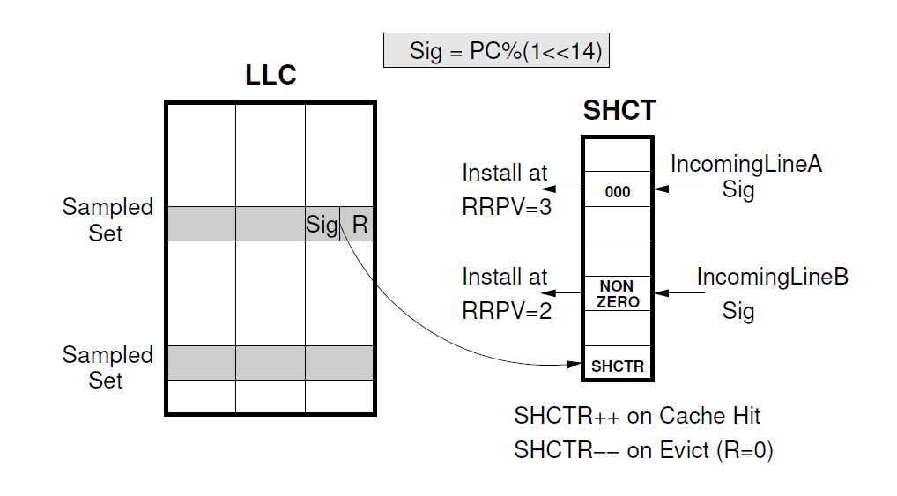
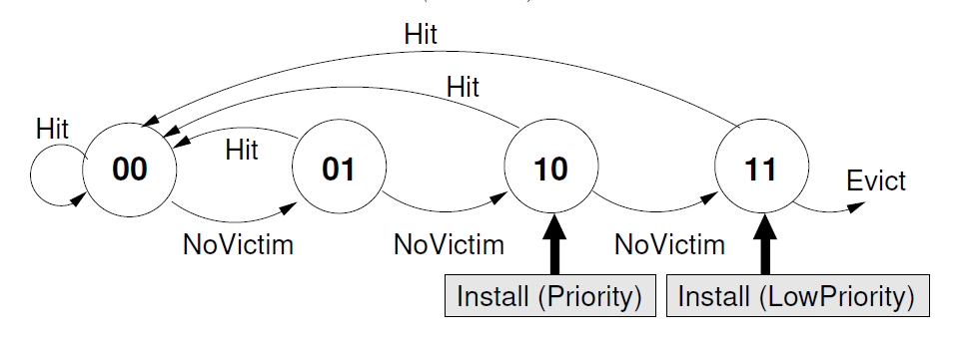
Background-SHiP
SHiP uses RRIP policy
Signature History Counter Table
SHCT determines insert priority
64 sampled sets used for SHCT
14-bit PC signature for indexing
Reuse bit for each sampled set

Slide 4
Background-SHiP++
When SHCT max value Insert new block at RRPV equals zero
Only increment SHCT on first hit
Weights hits and evictions similarly
Writeback always has RRPV equals three
Separate demand accesses and prefetch accesses in SHCT
(signature = (PC << 1)+is_prefetch)
Prefetch-Aware RRPV Updates

Slide 5
Abstract
Add bypassing to avoid inserting low re-referenced blocks
Dynamically check effectiveness
Accurately update SHCT even with bypassing
Evict writeback blocks first
Typically lower re-use
Accurately update SHCT with writeback priority eviction
Have better performance than SHiP++

Slide 6
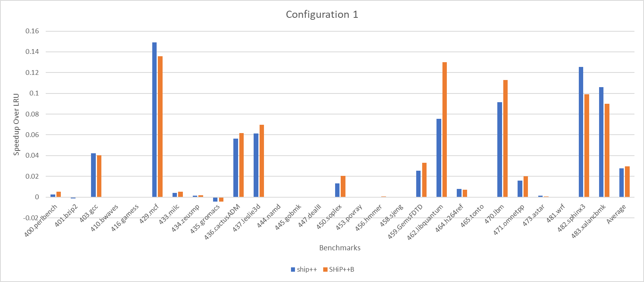
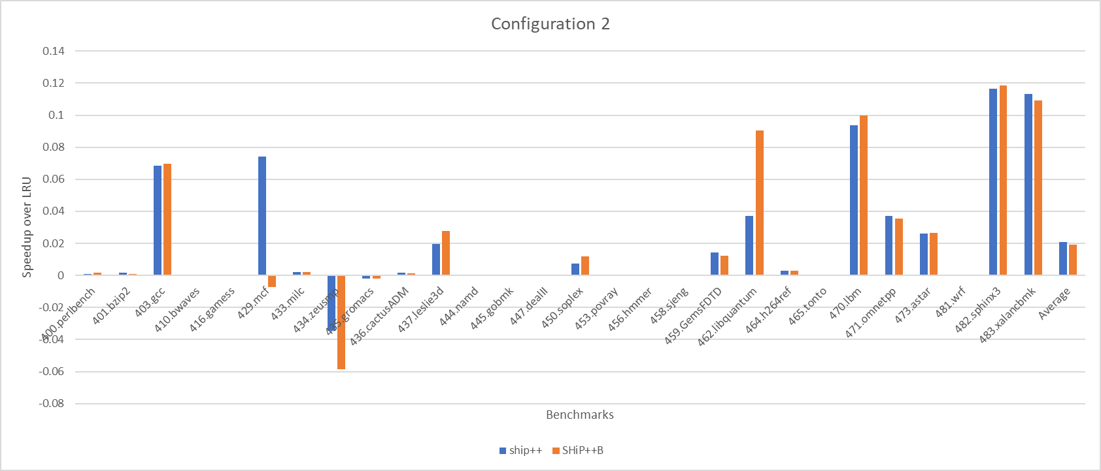
Adding Bypassing to SHiP++
Bypass when SHCT is zero
Bypass to decrease the number of unreferenced blocks placed in cache
No dynamic checking
Some promising benchmarks
Slightly better average config 1
Worse average for config 2

Slide 7
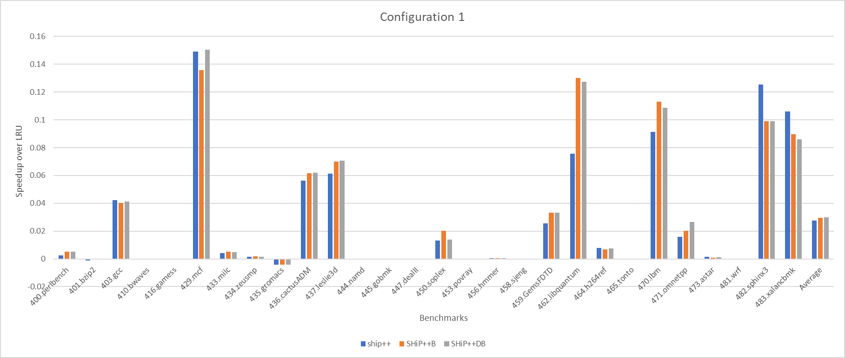
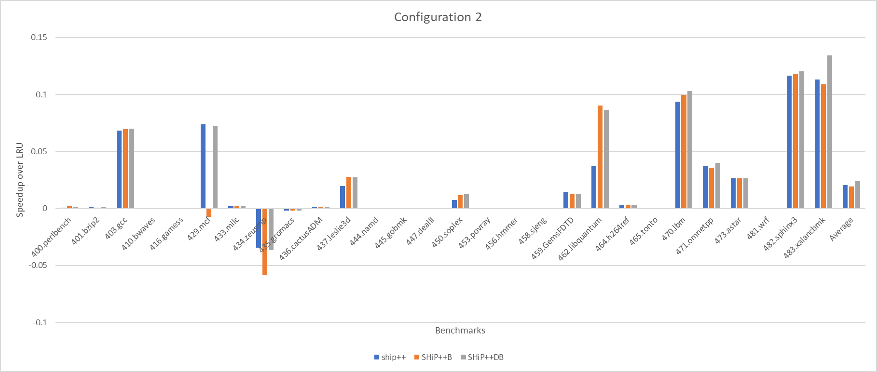
Improving Bypassing
Dynamically check every 10k instructions to only use bypassing when helpful
Calculate current IPC
Run opposite method for 500 instructions (no bypass or bypass)
Compare and choose higher IPC method

Slide 8
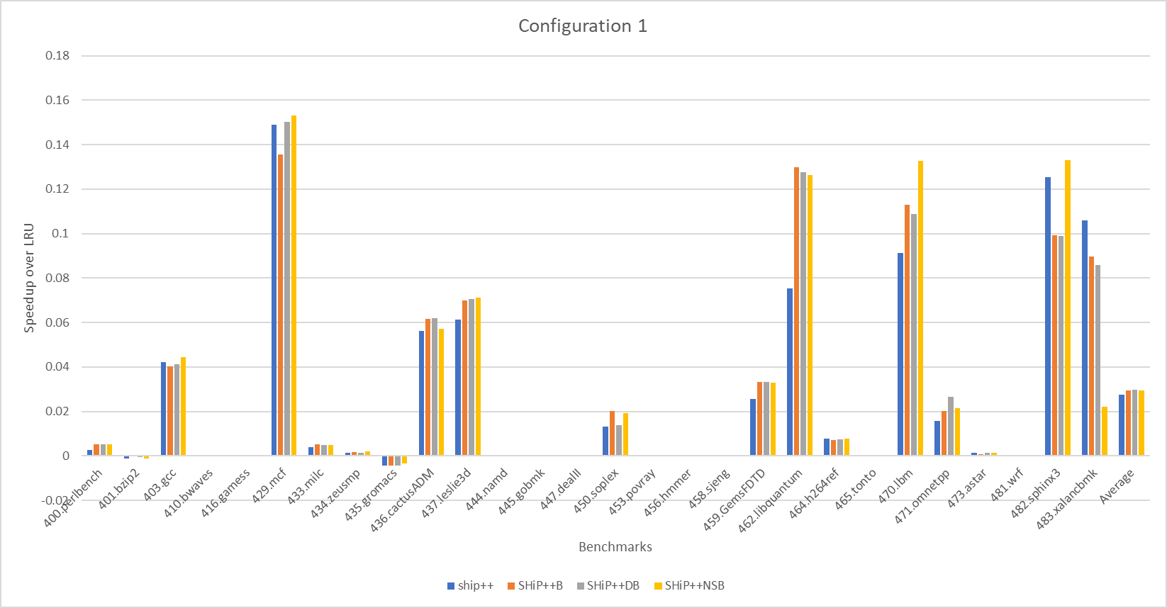
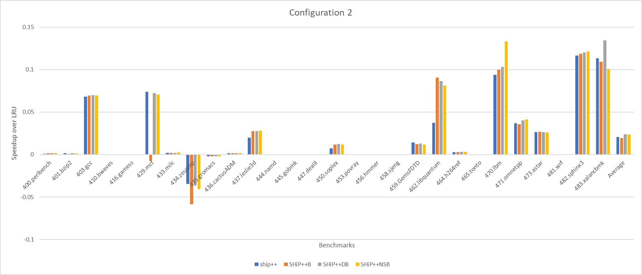
Improving Bypassing
No bypassing on sample sets
No dynamic checking for initial testing
Idea is to allow for up to date learning of SHCT while still getting the benefits of bypassing

Slide 9
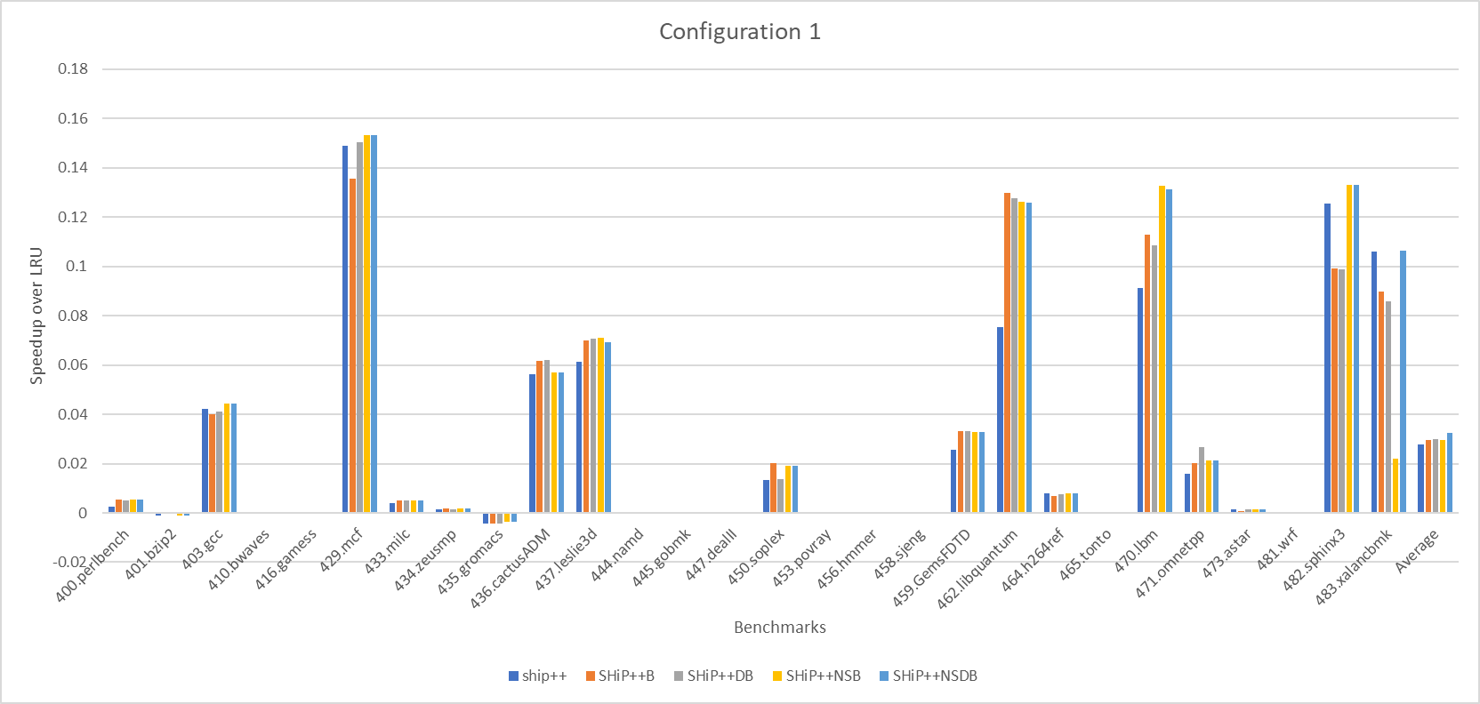
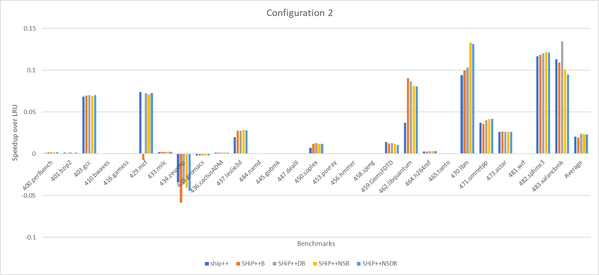
Final Bypassing Implementation
Combined dynamic bypassing and no sample set bypassing
Changed dynamic checking
Every 1 million instructions
Get current methods IPC over next 10k instructions
Switch methods and give 10k instr warmup
Get IPC over next 10k instructions
Compare IPC and choose better method to use until the next check

Slide 10
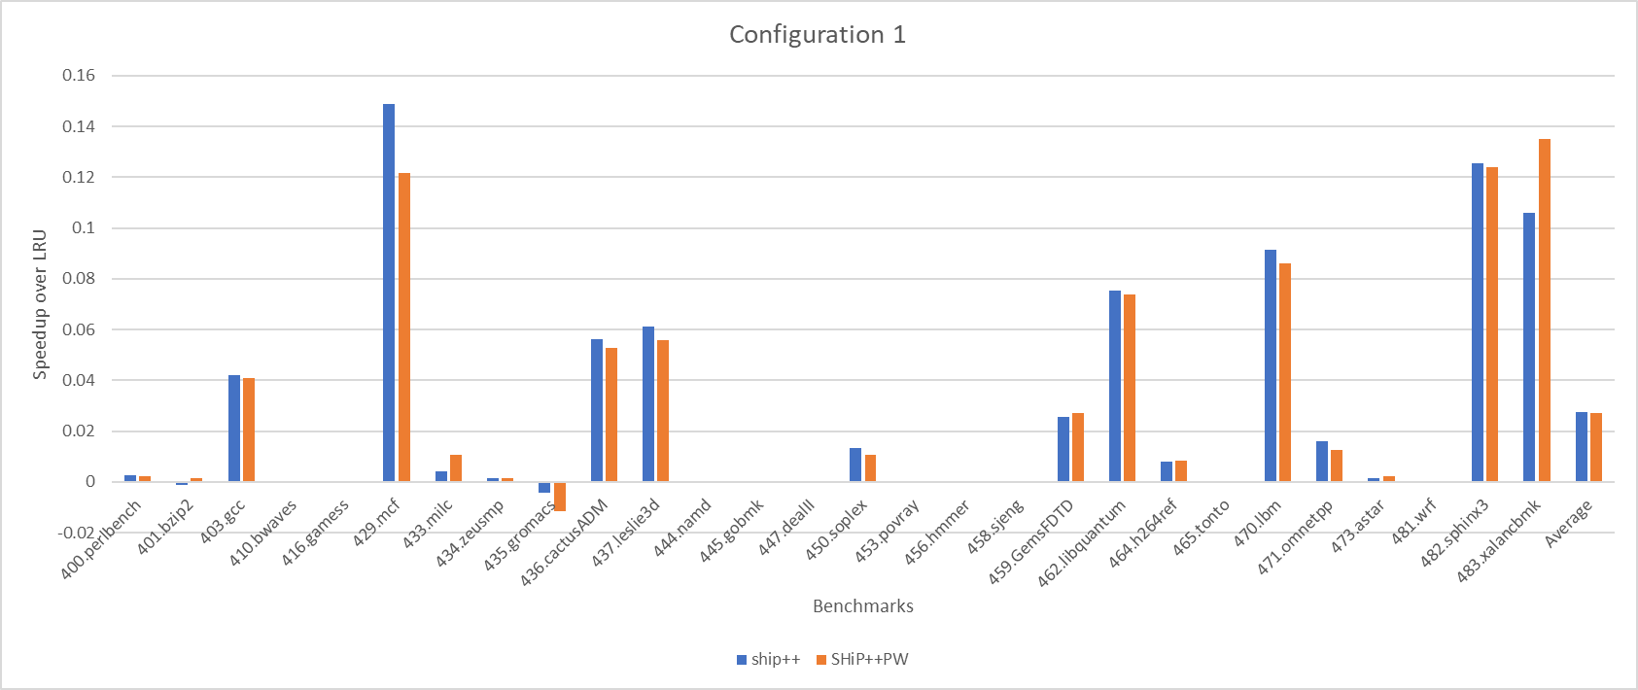
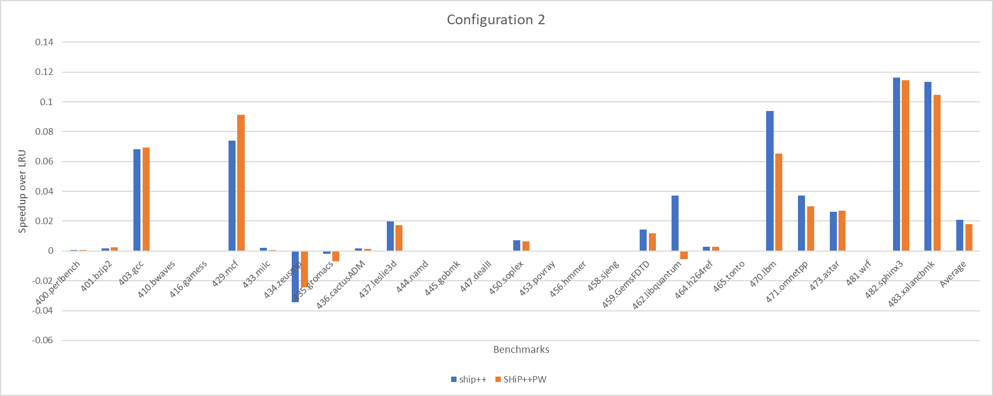
Priority Writeback Eviction
Evict Writeback blocks before evicting other blocks with RRPV equal to three
The idea is to evict the typically lower re-used writeback block first in order to keep more useful blocks in cache

Slide 11
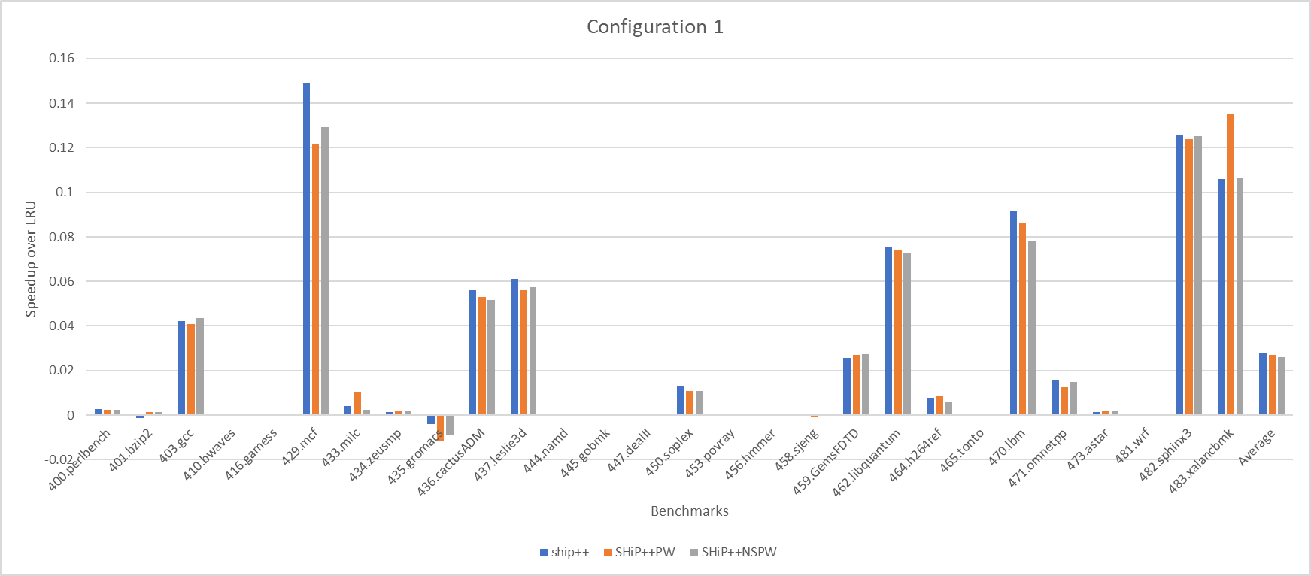
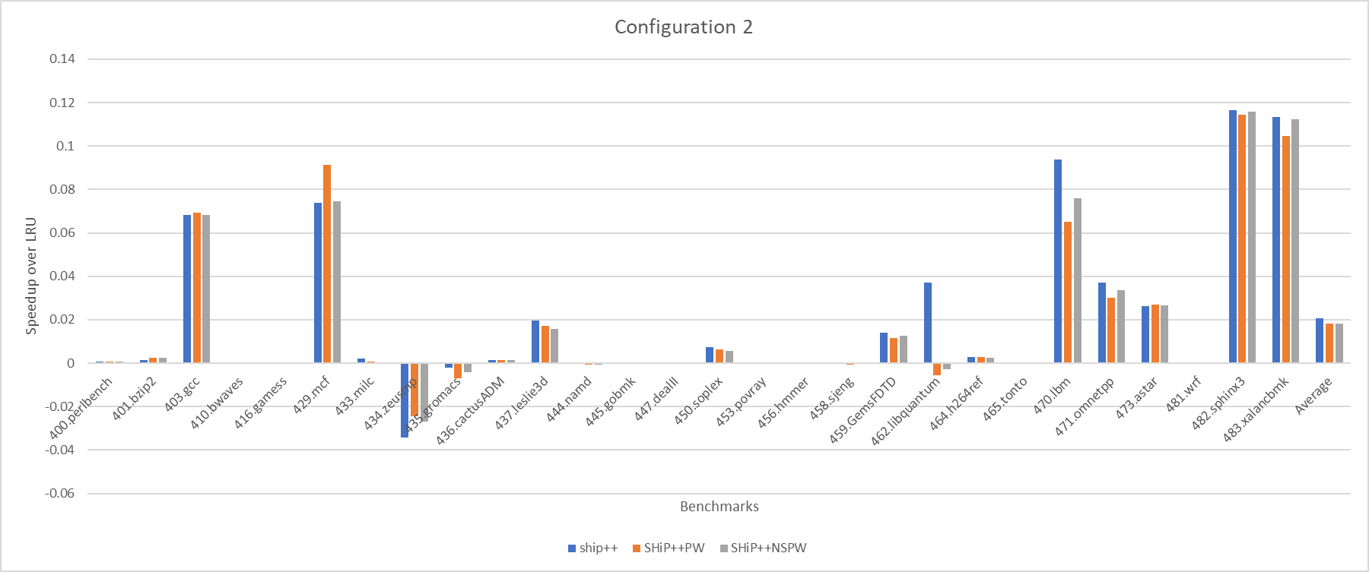
Improving Priority Writeback Eviction
Do not use Priority Writeback Eviction on sample sets
Idea is to keep updating SHCT as it was before
Try to reduce some of the bottlenecks introduced

Slide 12
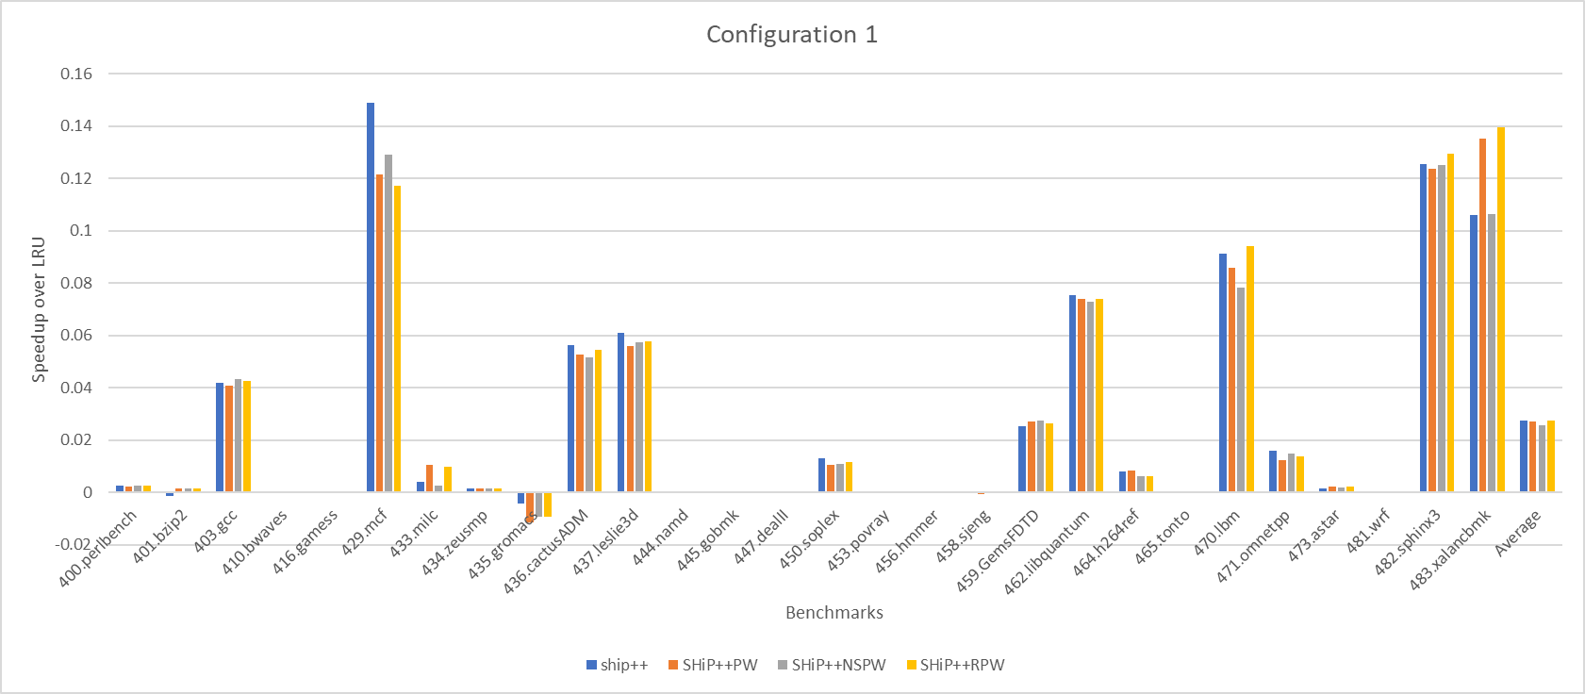
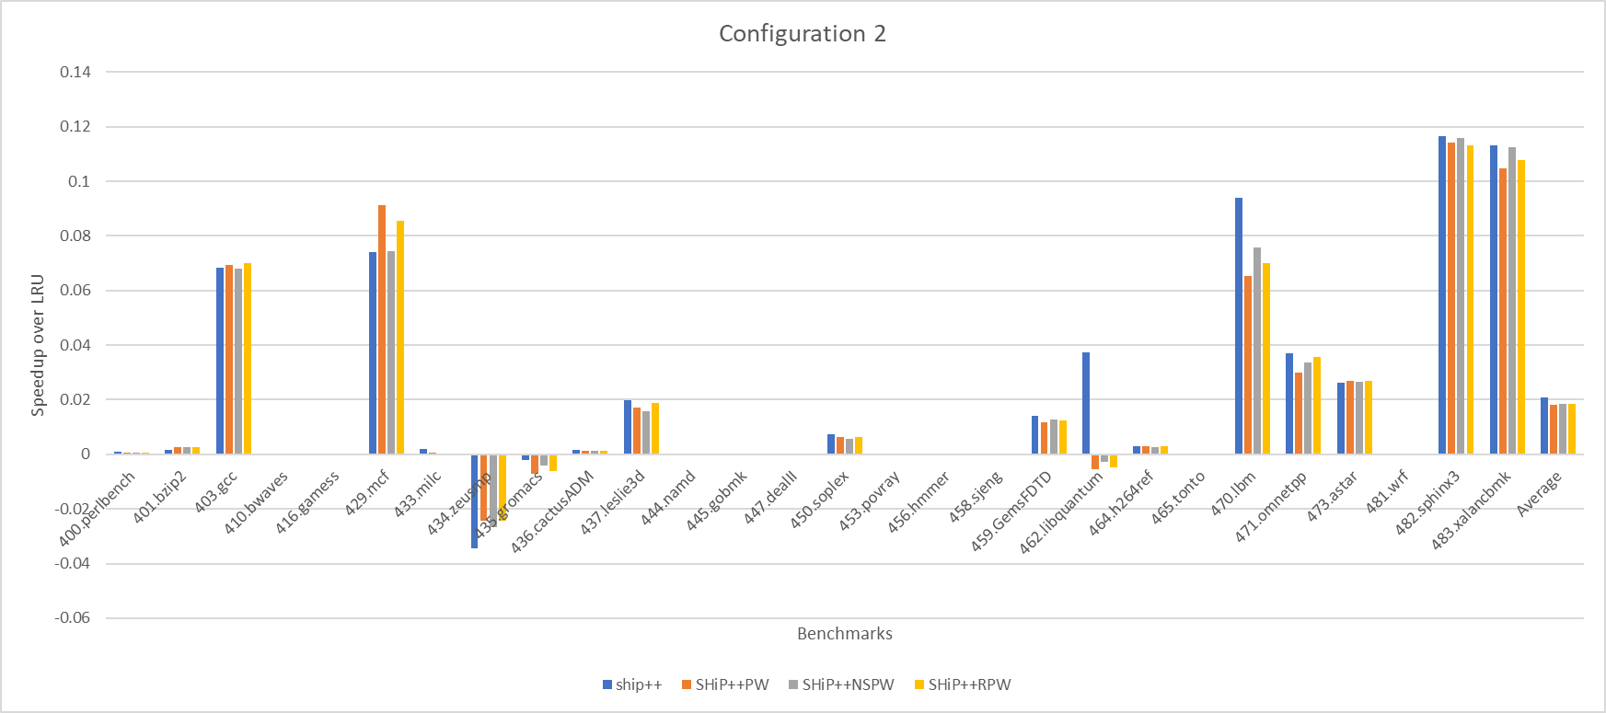
Final Priority Writeback Eviction Implementation
Half the time do not use Priority Writeback Eviction on sample sets to allow for normal re-learning of behavior
Try to get benefits of previous implementations with less negatives
Overall when added to SHiP++ on its own it is pretty bad

Slide 13
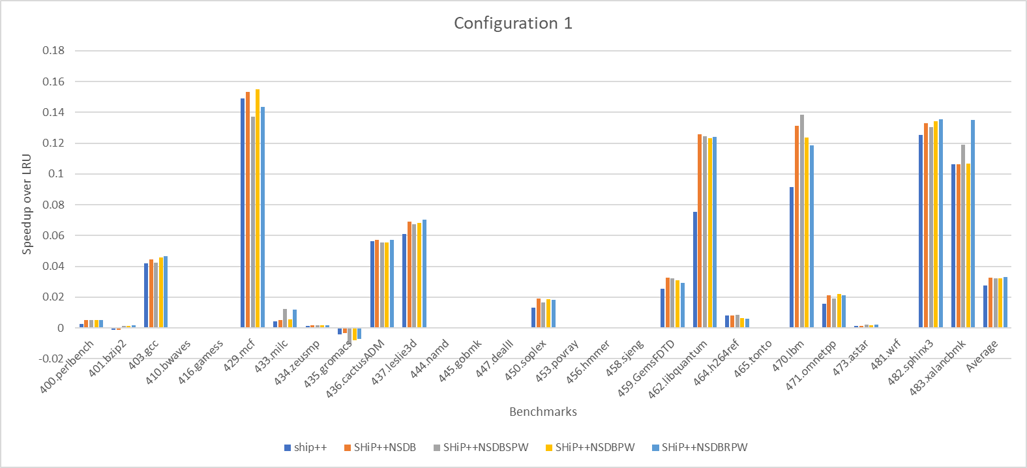
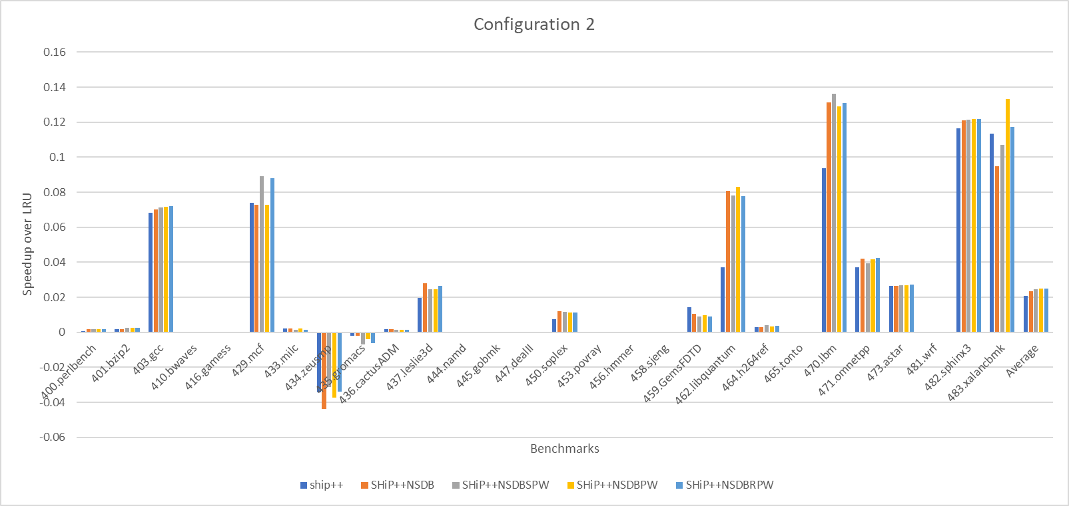
Combining Bypassing and Priority Writeback Eviction
Configuration 1 is similar to just Bypassing
Configuration 2 is better with doing both changes together

Slide 14
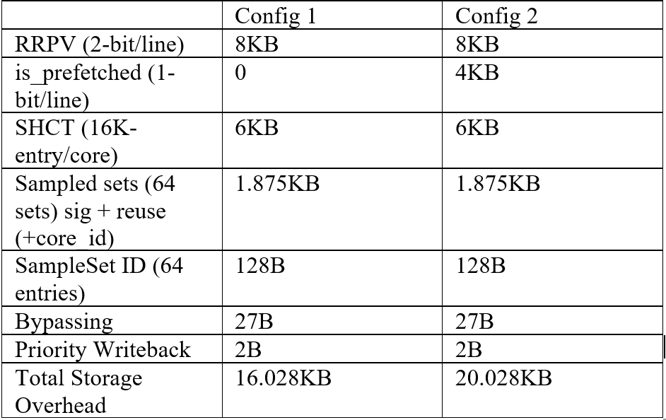
Overhead
Increase in 29 Bytes of overhead compared to SHiP++

Slide 15
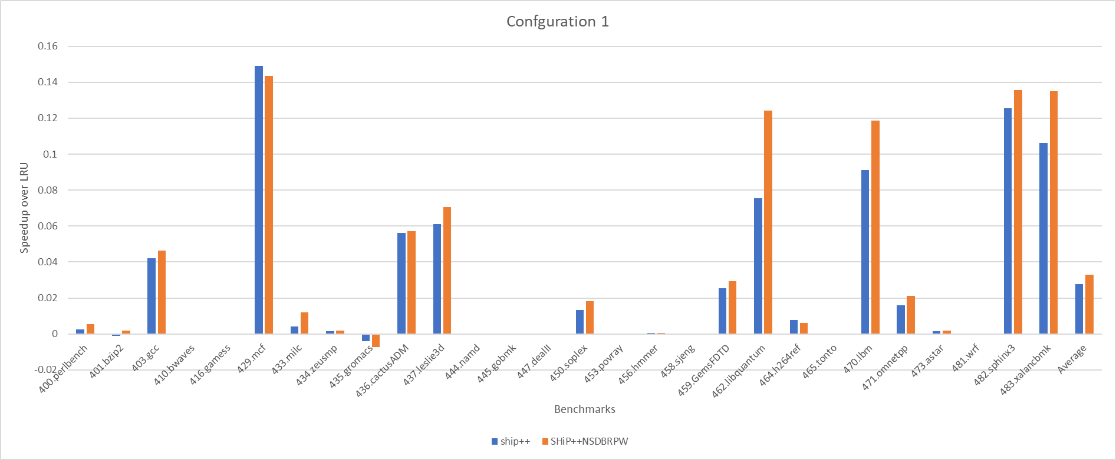
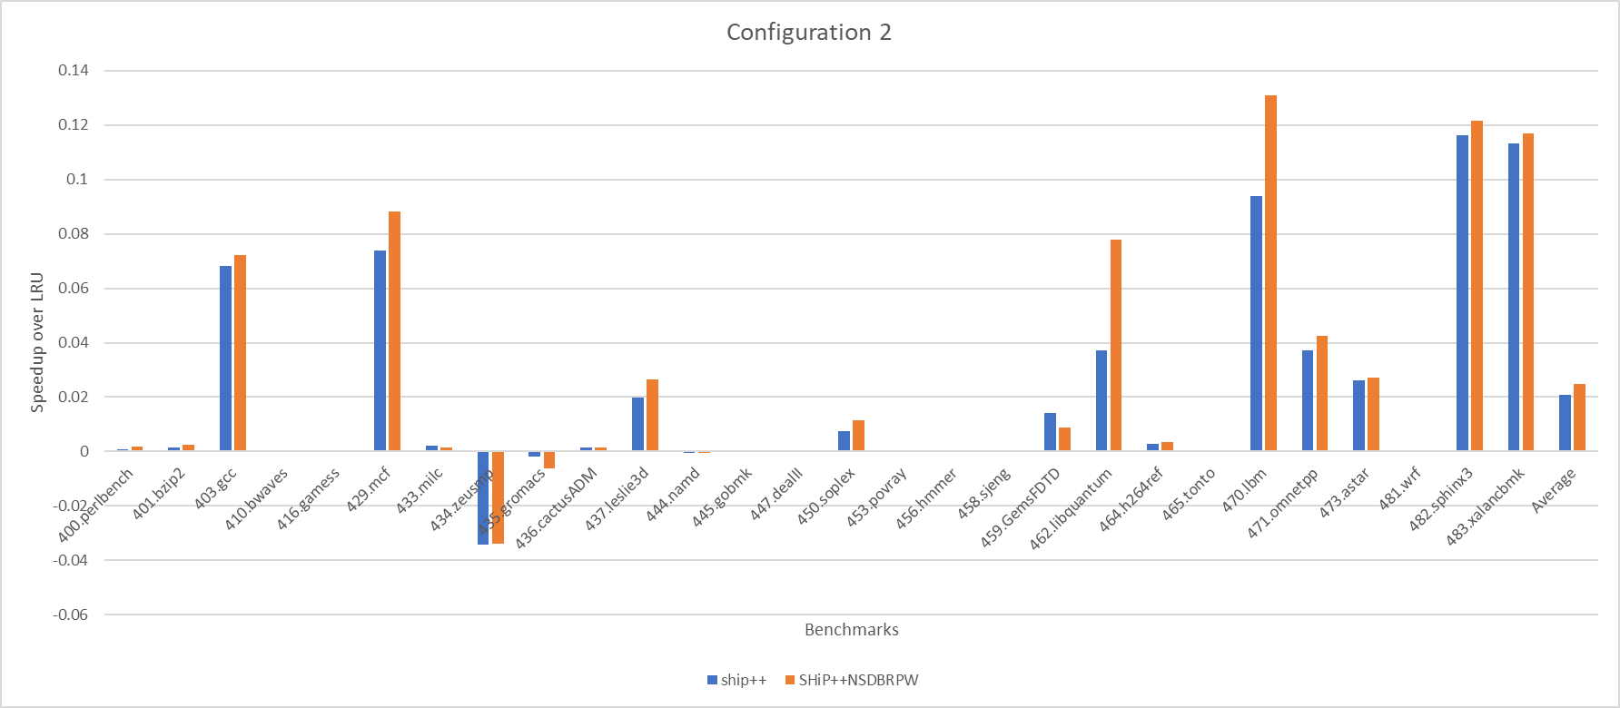
Conclusion
Config 1 Speedup over LRU
SHiP++ 2.76% faster on average
Modified SHiP++ is 3.29% faster
19.2% improvement
Config 2 Speedup over LRU
SHiP++ 2.07% faster on average
Modified SHiP++ is 2.48% faster
19.8% improvement

Slide 16
References
SHiP++: Enhancing Signature-Based Hit Predictor for Improved Cache Performance, V. Young, C. Chou, A. Jaleel, M. Qureshi, 2nd Cache Replacement Championship, 2017.

